Slide 1
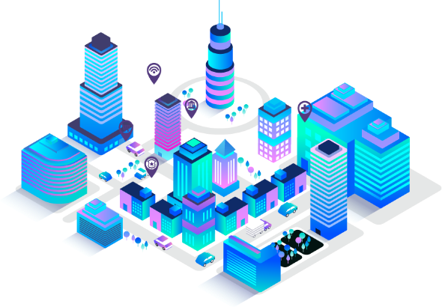
Our Team:
Hackademic
Vision
SURYA NARAYANAN CS RITHVIKAILAS G VELMURUGAN
THEME:
Assistive Technology

Slide 2
Problem Statement :
* In our society we have people with disabilities.
* It is globally estimated that 1.3 billion people live with some form of distance or near vision impairment and 2 billion people are dumb.
* Communications between deaf-mute and a normal person have always been a challenging task especially in the public place.
* Dealing with sight loss is a great challenge.

Slide 3
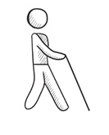
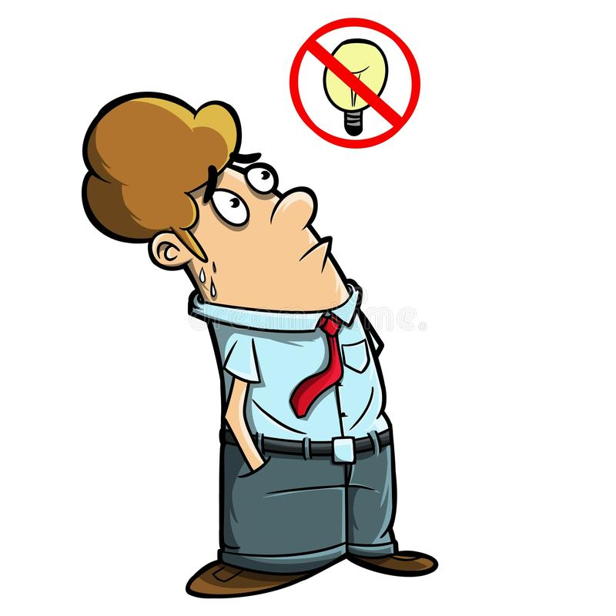
Solution:
Our system focuses on the problem of gesture recognition in real time that sign language and the obstacle detection in real time used by the community of blind people and dumb people.
Our idea is to curb the challenges faced by the blind people and dumb people. Our device is a light-weighted wearable glove which contains multiple specifications to help the blind people with obstacle detection and sign language translator for the dumb.

Slide 4
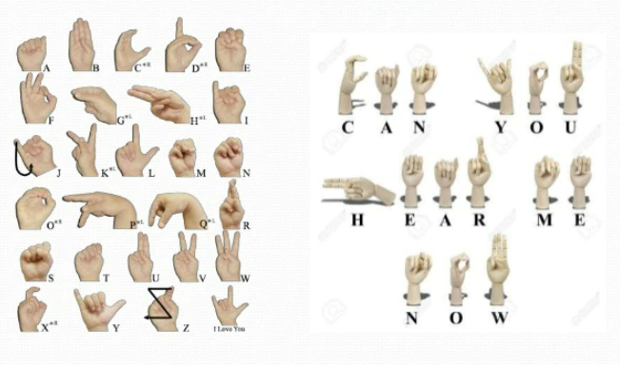
Hand Gesture Recognition:
Human beings have the ability to express their emotions and feelings through the speech but some unfortunate ones do not have the ability. They cannot speak and listen.
Our project presents a man machine interface using video camera. The system will use a single, color camera mounted above a neutral colored desk surface next to the output device. The output of the camera will be displayed on the monitor. Shape and position information about the hand will be gathered using detection of skin.

Slide 5
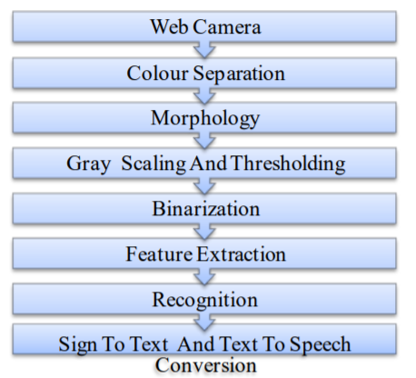
Algorithm:
. In our system, image is captured through web camera. The system is implemented in offline mode and also in real time mode. Input images are applied to image pre processing and segmentation in which, object and background is separated. Resultant image has shown some features. Then feature extraction and recognition was done by using PCA and KNN. Finally, this result is converted into text and voice.
1. Database Creation
2. Preprocessing
3. Feature Extraction
4. Recognition

Slide 6
Obstacle detection using glove
The glove is equipped with ultrasonic sensors that explore the surroundings: it provides vibrotactile feedback on the position of the closest obstacles in range and lets users know by a vibrating motor and voice app.
Spatial Orientation- The user will be able to detect the distance from objects through the use of haptic technology in the glove.
Color Recognition- Through a click of a button, the glove will be able to say aloud the colour of the object the user has in their hand.
Detection of light intensity- The user can be told whether they are in a room present with light, and at the same time, whether the light is natural or artificial. The glove will be able to say the date and time to the user.
Panic Button- If the user is lost, through a combination of buttons, the glove will be able to send the location via text message to a guardian or friend, whose contact details are stored in the app connected to the glove.

Slide 7
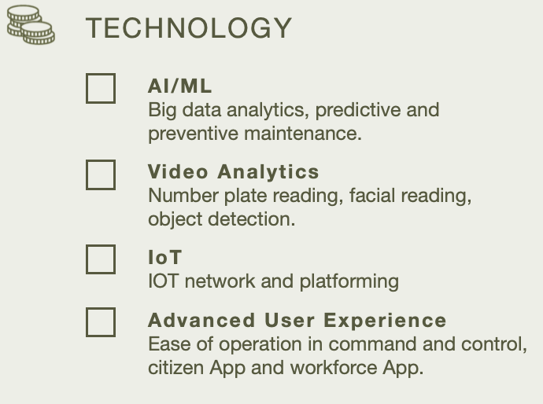
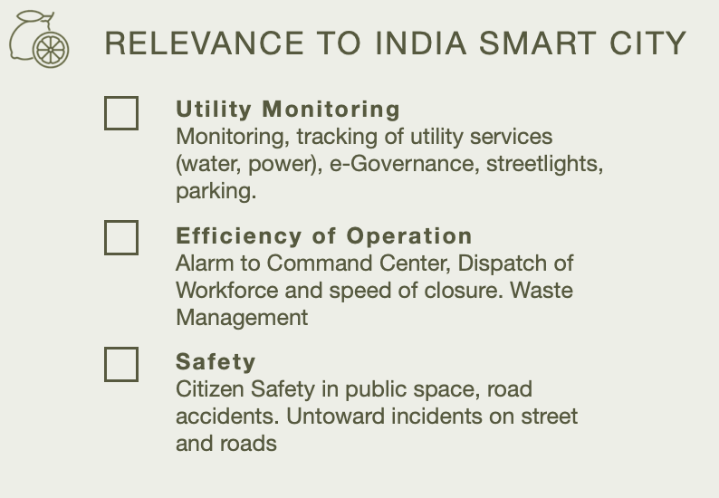


Slide 8
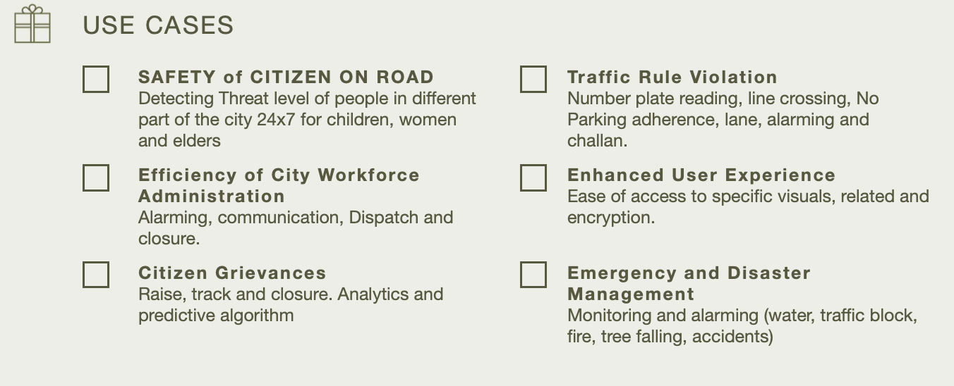

Slide 9
FUTURE VISION:
Sign language recognition system for deaf and dumb people using image processing will be successfully executed with high accuracy.
Obstacle detection with vocal audio is being implemented by our team and will have more features than mentioned.
We want to make the blind and dumb people to communicate like normal people.
We want to make more products for the comfort of differently abled people.

